Slide 1

Ski Resort price analysis
Big Mountain Resort - Montana

Slide 2
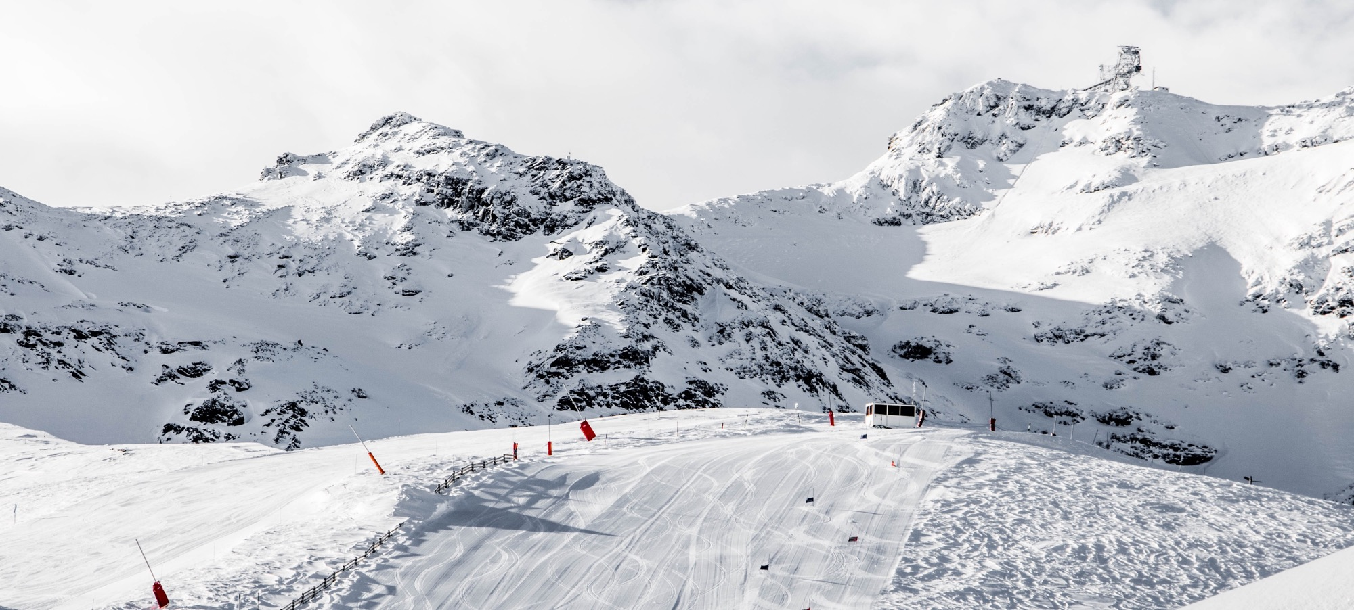
Problem identification
Notes:
© Copyright Showeet.com – Free PowerPoint Templates

Slide 3
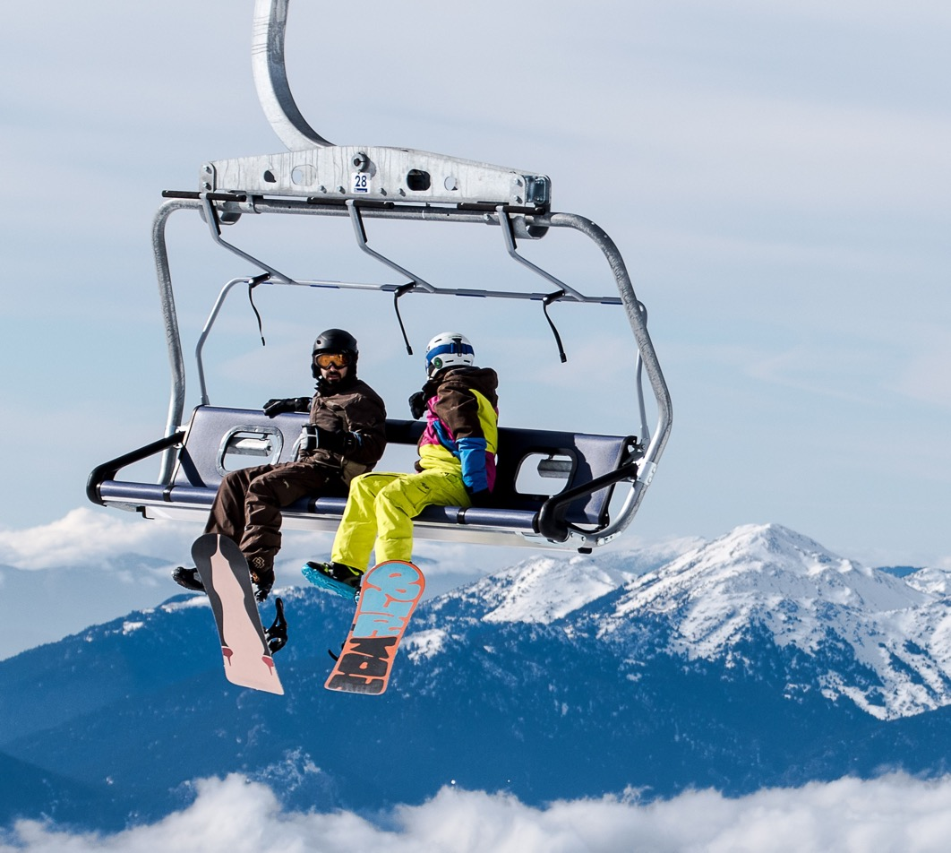
Big Mountain Ski Resort
Big Mountain Ski Resort located in Montana with spectacular view:
About 350,000 annual visitors
Access to 105 trails
Serviced by 11 lifts, 2 T-bars, and 1 magic carpet
Longest run of 3.3 miles
Base elevation of 4,464 ft
Summit elevation of 6,817 ft
Vertical drop of 2,353 ft
Notes:
© Copyright Showeet.com – Free PowerPoint Templates

Slide 4
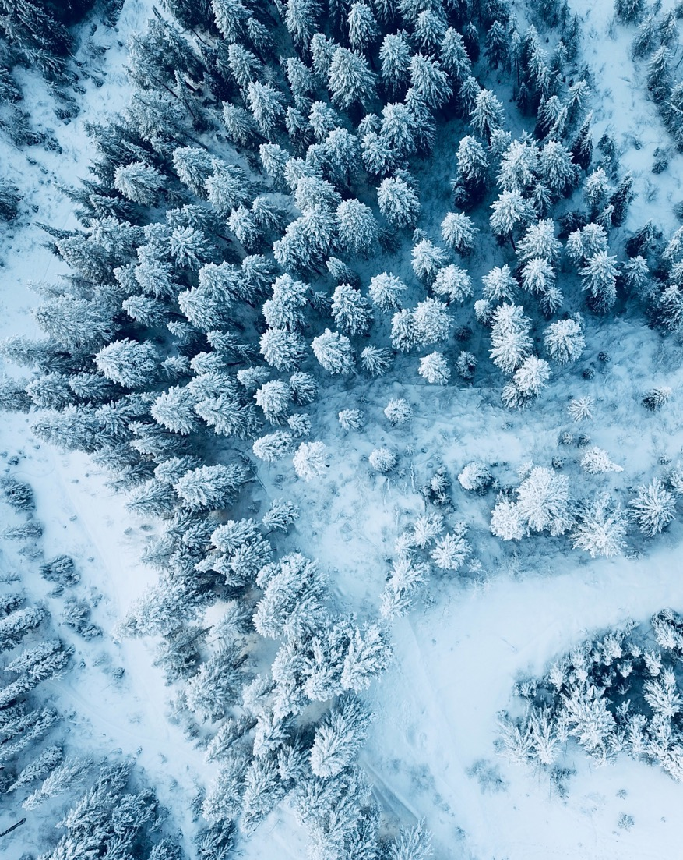
Pricing strategy
Big Mountain Resort current ticket price is above average in the market.
It is suspicious whether this pricing strategy is good enough in terms of return on investment.
Business questions:
How to select a better-value ticket price
What changes to implement that support price increase or cost cuts without higher priced tickets
Notes:
© Copyright Showeet.com – Free PowerPoint Templates

Slide 5
Modeling and Analysis
Notes:
© Copyright Showeet.com – Free PowerPoint Templates

Slide 6
Price model features
Resort Count per State
The data for 330 ski resorts in the market including Big Mountain Resort is collected and analyzed.
New York and Rhode Island have respectively the highest and the lowest number of resorts in this market.
Average weekend price per state is used as the target for prediction model and some other features are collected per state.
By combining state and resort data, new features are created per resort that shows their current share of the supply.

Slide 7
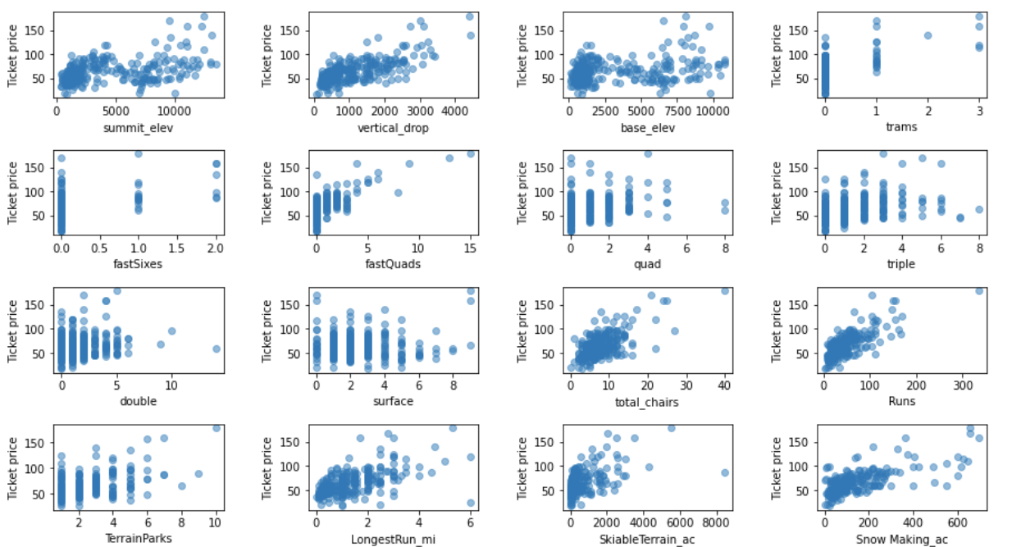
Price model features

Slide 8
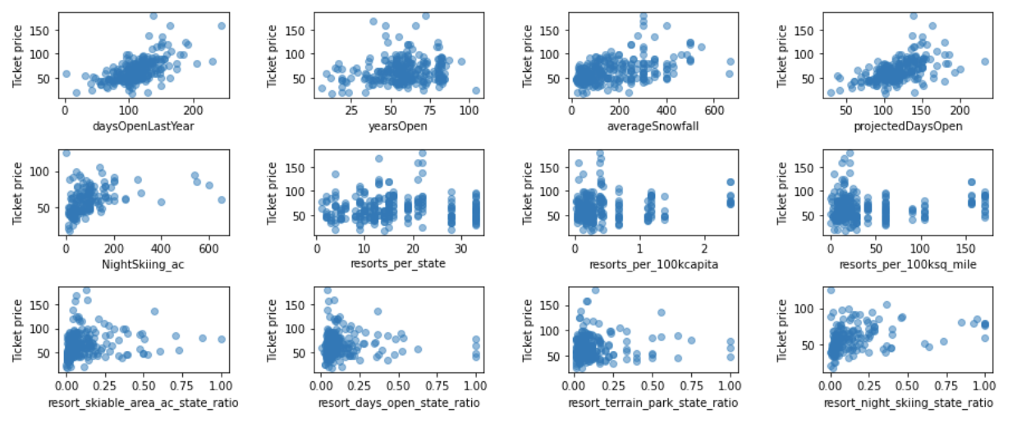
Price model features

Slide 9
Predictive Models
Linear Regression
Missing values imputed using median
Trained on 70% of the data using 8 best features selected
Validated using 5-fold cross validation
Features scaled (mean of 0 and std. of 1)
Random Forest
Missing values imputed using median
Trained on 70% of the data using 4 best features selected
Validated using 5-fold cross validation
Features NOT scaled (was not helpful)
Number of estimators tested from 10-1000 and 69 selected
Both metrics show that RF outperforms LR

Slide 10
key findings
Notes:
© Copyright Showeet.com – Free PowerPoint Templates

Slide 11
Findings
Big Mountain Resort ticket price predicted by the Random Forest model is $95.
This suggests a 17% increase in their current price ($81)
Top four dominant features in predicting the ticket price are:
fastQuads
Runs
Snow Making_ac
vertical_drop

Slide 12
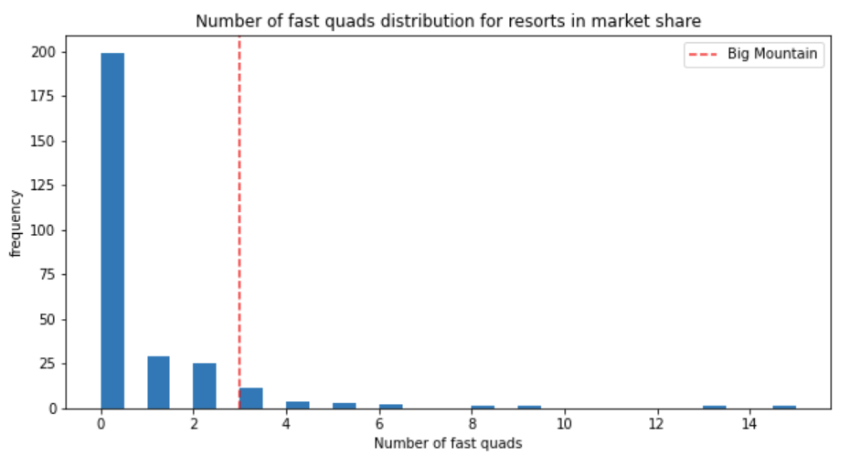
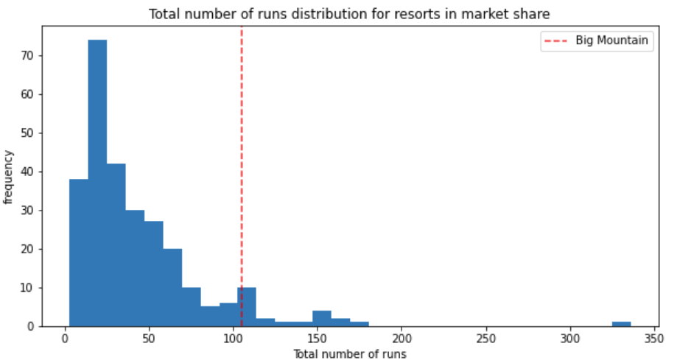
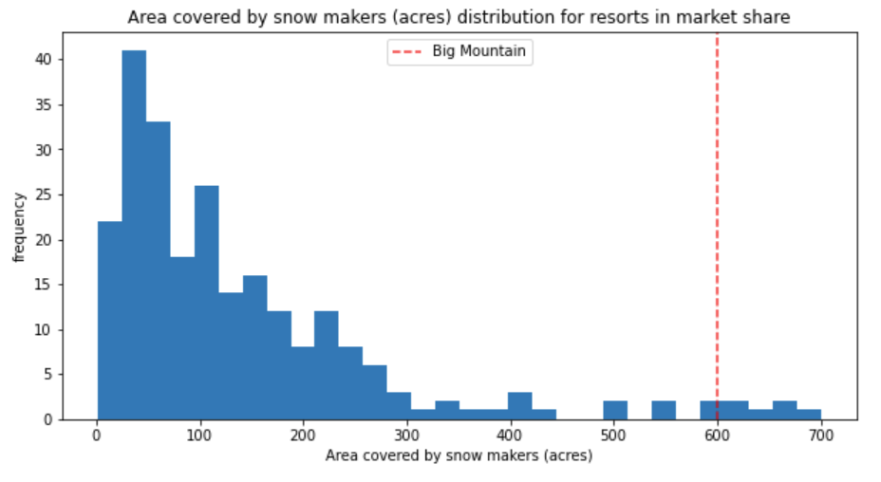
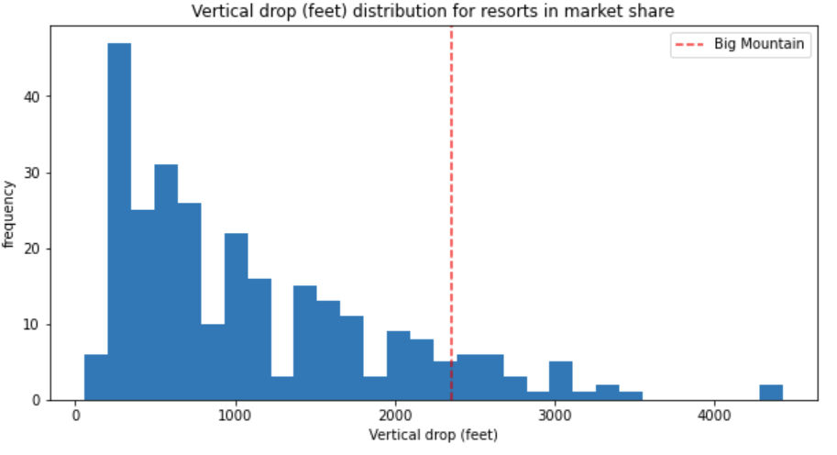
Big Mountain resort is doing well for the four most significant features

Slide 13
Conclusions
Notes:
© Copyright Showeet.com – Free PowerPoint Templates

Slide 14
Summary & recommendations
Price Increase
Big mountain resort has many great features putting it among the best resorts in its market. This support the recommended ticket price increase by up to 17%
Facility Change (without Price Increase)
Permanently closing down a number of runs is NOT recommended due to the significant revenue drop
Increasing vertical drop by 150 feet using an additional run as well as adding another chair to the facility will lead to approximately $3,474,638 increase in revenue

Slide 15
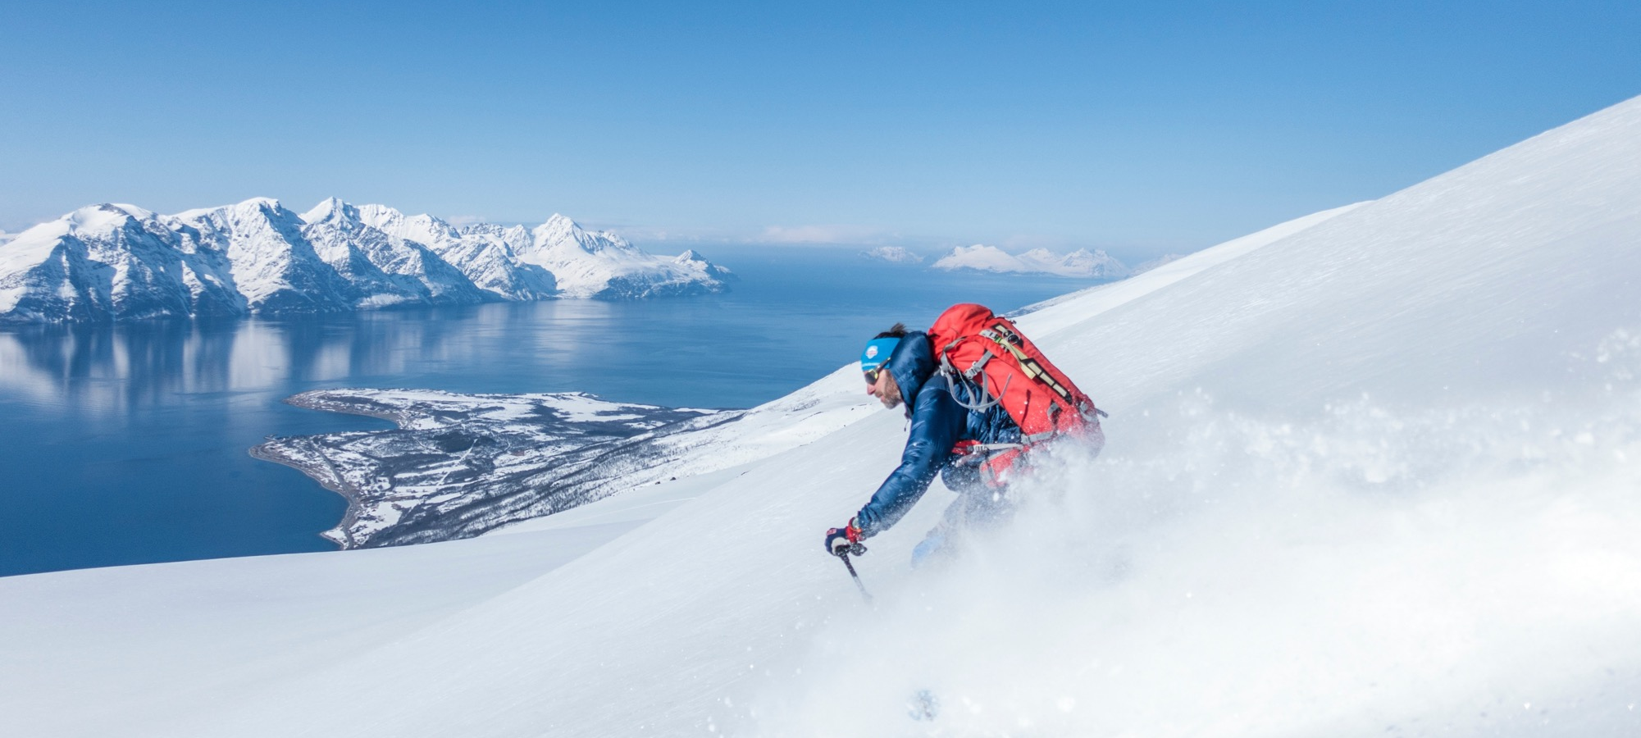
Large Image slide
Thank you!
Notes:
© Copyright Showeet.com – Free PowerPoint Templates

